Slide 1
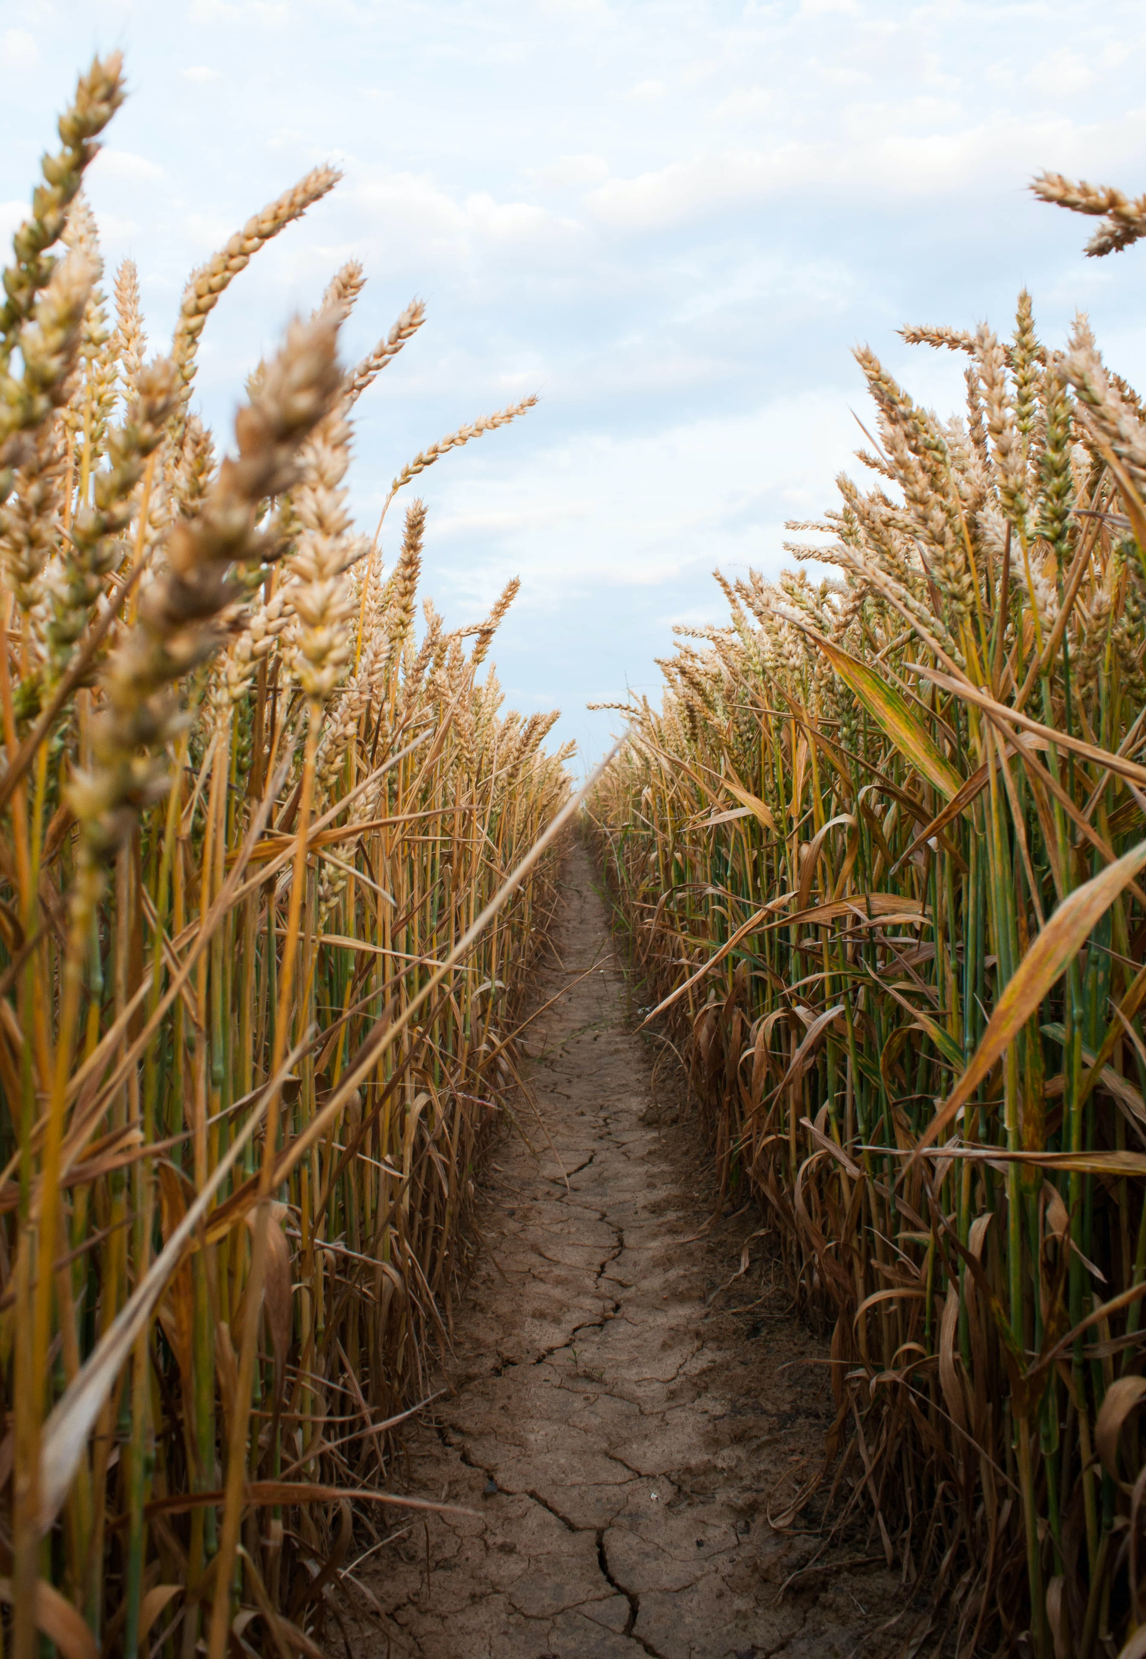
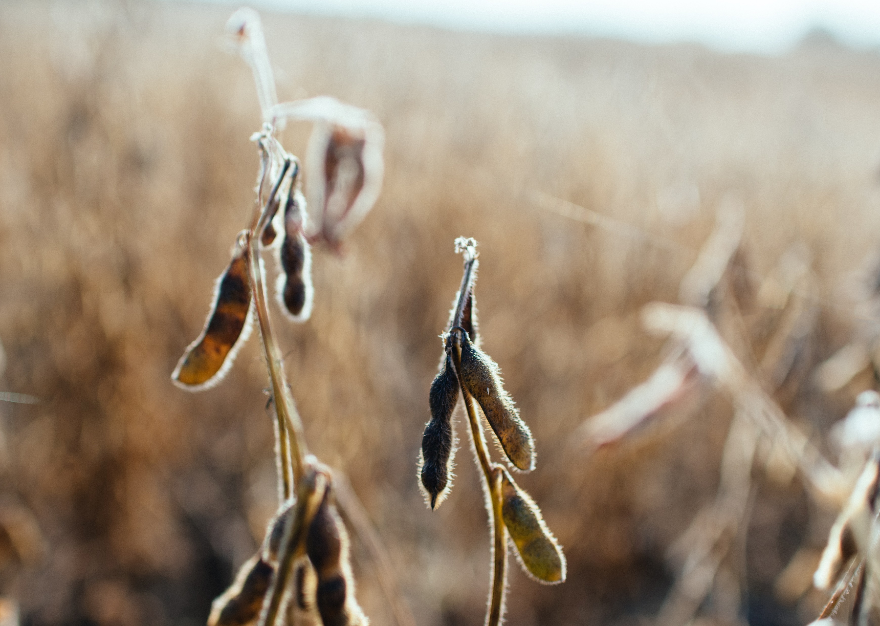
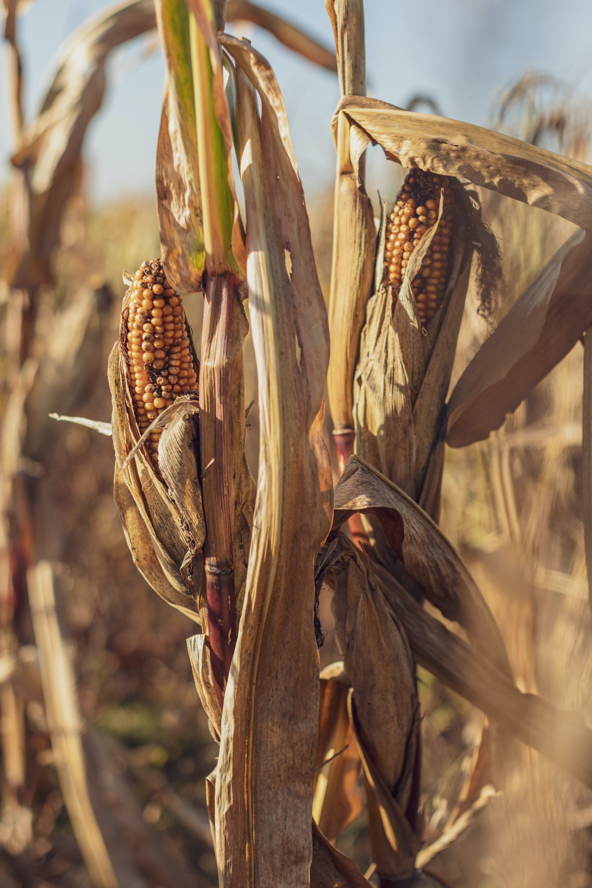
PROJECT 1:
CAN WE PREDICT THE PRICE OF AGRICULTURAL COMMODITIES ETF’s
CORN
Futures sticker symbol : C
ETF name: CORN
SOYBEAN
Futures sticker symbol : S
ETF name: SOYB
WHEAT
Futures sticker symbol : W
ETF name: WEA
data_farming

Slide 2
OBJECTIVES:
1 – Identify main producing states
2 – Identify ETF’s vs Futures counterpart correlations.
3 – Identify weather vs production correlations
4 – Identify trigger indicators: Long or Short
data_farming

Slide 3
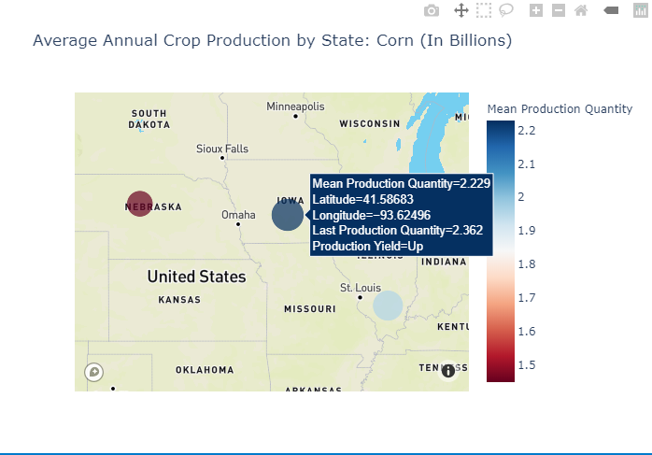
CORN PRODUCTION PANEL
PRODUCTION YIELD
data_farming
Data source: Crop Production (USDA)

Slide 4
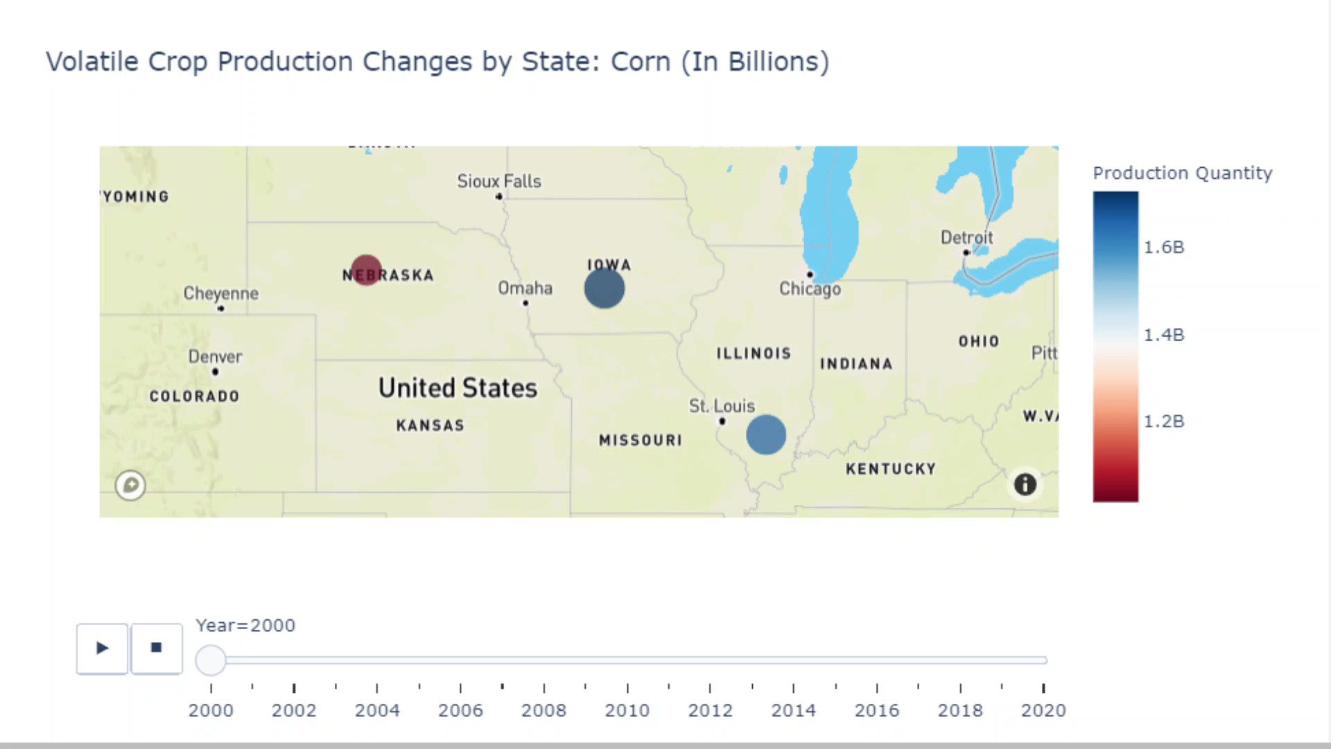
CORN PRODUCTION BY STATE
FROM YEAR 2000-2020
data_farming
Data source: Crop Production (USDA)

Slide 5

ETF’s vs FUTURES CORRELATIONS
data_farming
Data source: Alpaca and Tradestation

Slide 6
ETF’s vs FUTURES CORRELATIONS
data_farming
Data source: Alpaca and Tradestation

Slide 7
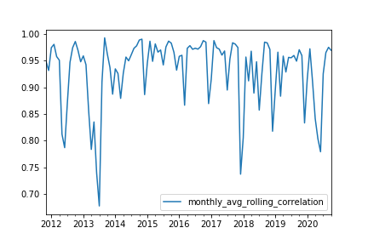
ETF’s vs FUTURES CORRELATIONS
data_farming
Data source: Alpaca and Tradestation

Slide 8
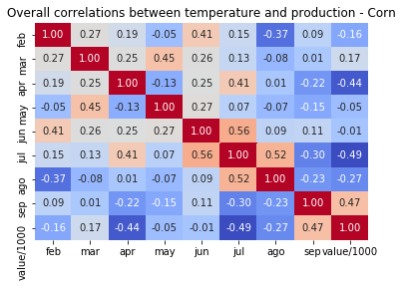
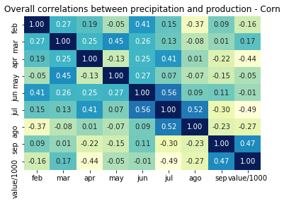
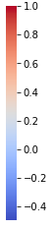
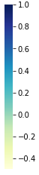
WEATHER CORRELATIONS
TEMPERATURES & PRECIPITATION -NEBRASKA
highly
Inversely
data_farming
Data source: Crop Prod. (USDA), ACIS and RCCs

Slide 9
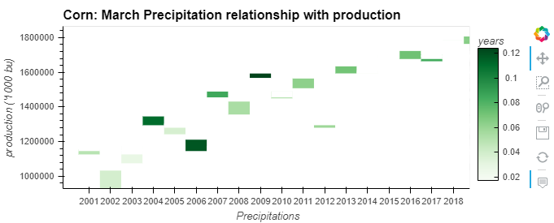
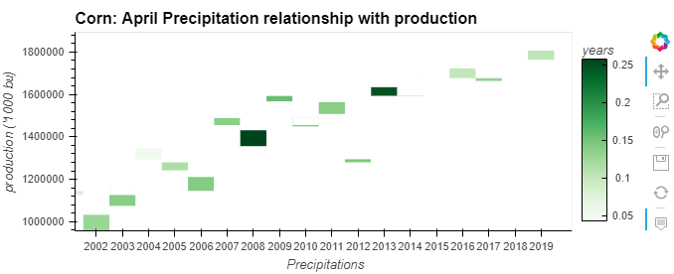
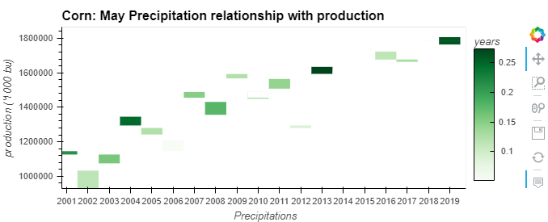
WEATHER CORRELATIONS
PRECIPITATIONS - SPRING
data_farming

Slide 10
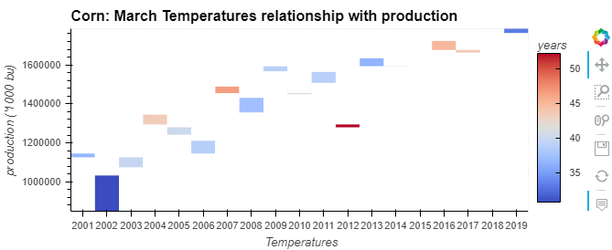
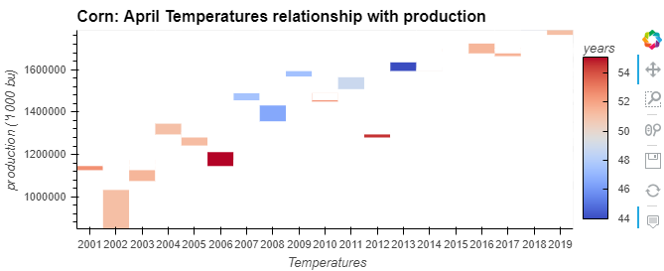
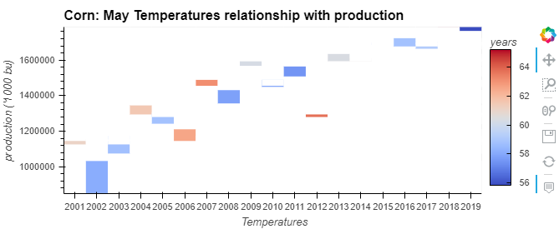
WEATHER CORRELATIONS
TEMPERATURES - SPRING
Is this low production
the result of a cold winter?
data_farming

Slide 11
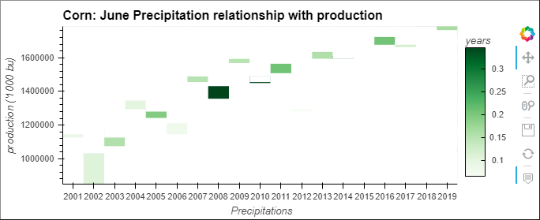
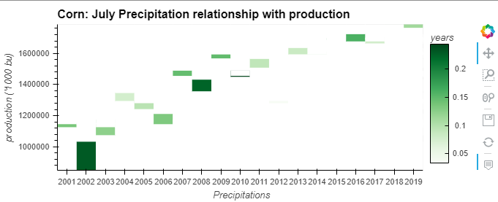
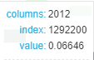
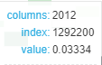
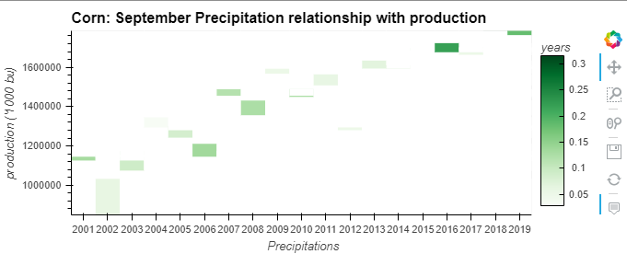
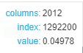
WEATHER CORRELATIONS
PRECIPITATIONS - SUMMER
data_farming

Slide 12
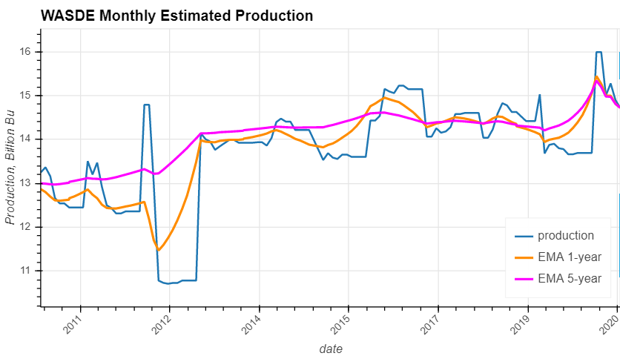
TRIGGER INDICATORS
EMA CROSSOVERS
data_farming
Data source: WASDE Report (USDA)

Slide 13
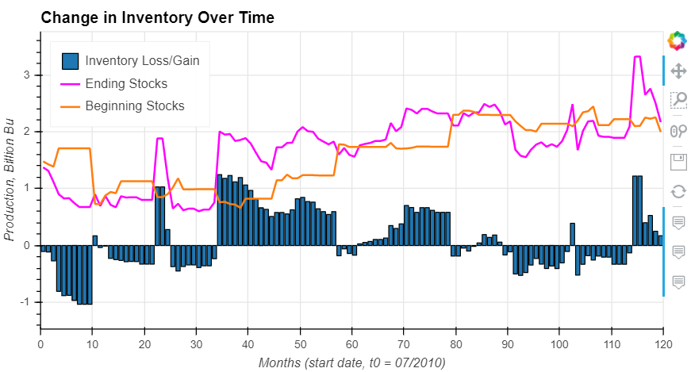
TRIGGER INDICATORS
INVENTORY CHANGES
data_farming
Data source: WASDE Report (USDA)

